Slide 1
Section 5.7
Integration: “Rectilinear Motion Revisited Using Integration”

Slide 2
All graphics are attributed to:
Calculus,10/E by Howard Anton, Irl Bivens, and Stephen Davis Copyright © 2009 by John Wiley & Sons, Inc. All rights reserved.

Slide 3
Introduction
In Section 4.6 we used the derivative to find velocity and acceleration for a particle in rectilinear motion.
v(t) = s’(t) and a(t) = v’(t) = s”(t)
In this section, we will use the integral to reverse the process.

Slide 4
Example

Slide 5
Computing Displacement by Integration
Since displacement is final position minus initial position, it can be written as follows in integral form:
This is a special case of a form of the Fundamental Theorem of Calculus from section 5.6:

Slide 6
Computing Distance Traveled by Integration
Distance traveled is different than displacement because it is the total of all of the distances traveled in both positive and negative directions.
Therefore, we must integrate the absolute value of the velocity function:
NOTE: Integrating velocity over a time interval produces displacement, and integrating speed over a time produces distance traveled.

Slide 7
Example
Use a and b as given in question.
First determine where the particle turns around, then use Theorem 5.5.5 to break into parts.

Slide 8
Analyzing the Velocity vs. Time Curve
As you hopefully saw in the last example, the integral is the “net signed area” under the velocity curve v(t) between time zero t₀ and time one t₁ (see graph on next slide) which gives you displacement.
The “total area” under v(t) between those times gives you distance traveled.

Slide 9
Distance Traveled vs. Displacement
Notice the sign change on A₂ for distance traveled.

Slide 10
Constant Acceleration
When acceleration is constant, we can work backwards to find formulas for position and velocity as long as we know the position and velocity at some point in time.
Example: Suppose that an intergalactic spacecraft uses a sail and the “solar wind” to produce a constant acceleration of 0.032 m/s² (a = .032). Assuming that the spacecraft has a velocity of 10,000 m/s (v(0) = 10,000) when the said is first raised, how far will the spacecraft travel in 1 hour?
NOTE: s(0) = 0
Remember:
Therefore, v(t) = .032t + C which is the integral of accel.
10,000 = .032 (0) + C so C = 10,000 gives
v(t) = .032t + 10,000 and
s(t) = .032t²/2 + 10,000t + C₂ the integral of v(t)
0 = .016(0)² + 10,000(0) + C₂ so C₂ = 0 gives
s(t) = .016t² +10,000t and since 1 hour = 3600 sec
s(3600) = .016(3600)² + 10,000(3600) is apprx 36,200,000 meters

Slide 11
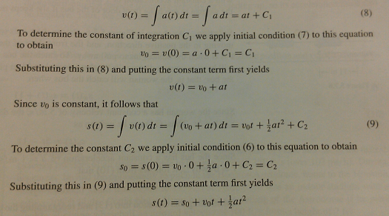
General Case of Constant Acceleration
We can use the same method from the previous example to find general formulas for velocity and position when acceleration is constant by integrating acceleration:

Slide 12
Free-Fall Model
Motion that occurs when an object near the Earth is imparted some initial velocity (up or down) and thereafter moves along a vertical line is called free-fall motion.
We assume the only force acting on the object is the Earth’s gravity which is constant (when sufficiently close to Earth). NOTE: We are disregarding air resistance and gravitational pull from the moon, etc. for now.
A particle with free-fall motion has constant acceleration in the downward direction (9.8 meters/second² or 32 feet/second²).
Therefore, the formulas developed on the previous slide apply and a = -acceleration due to gravity (g).

Slide 14
Examples
There are examples on page 381 that my be helpful.
They are similar to the spacecraft example, but include gravity.

Slide 15
Paris from atop the Eiffel Tower

